Slide 1
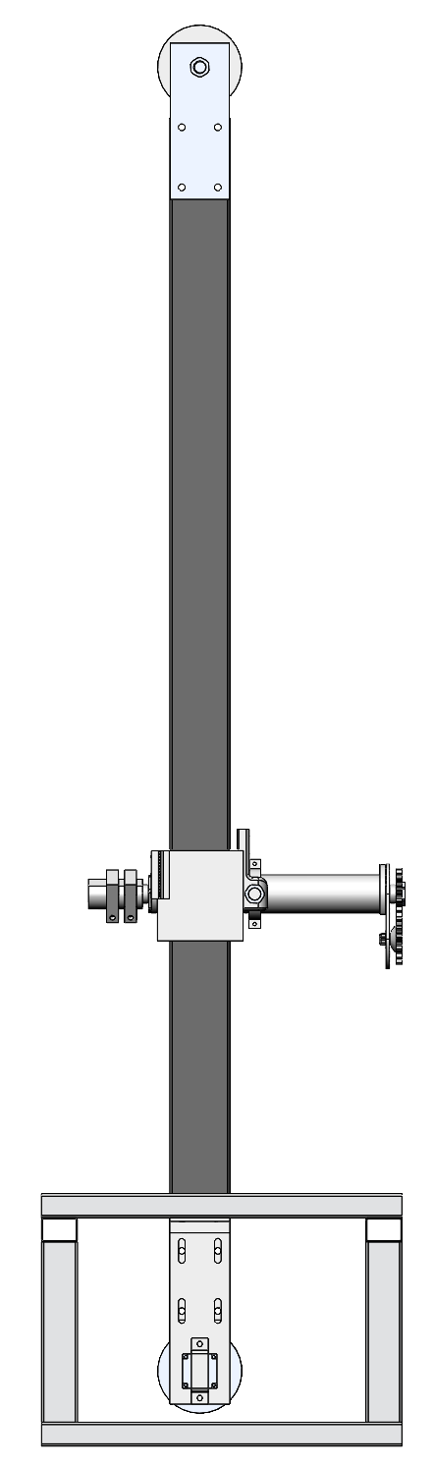

Slide 2
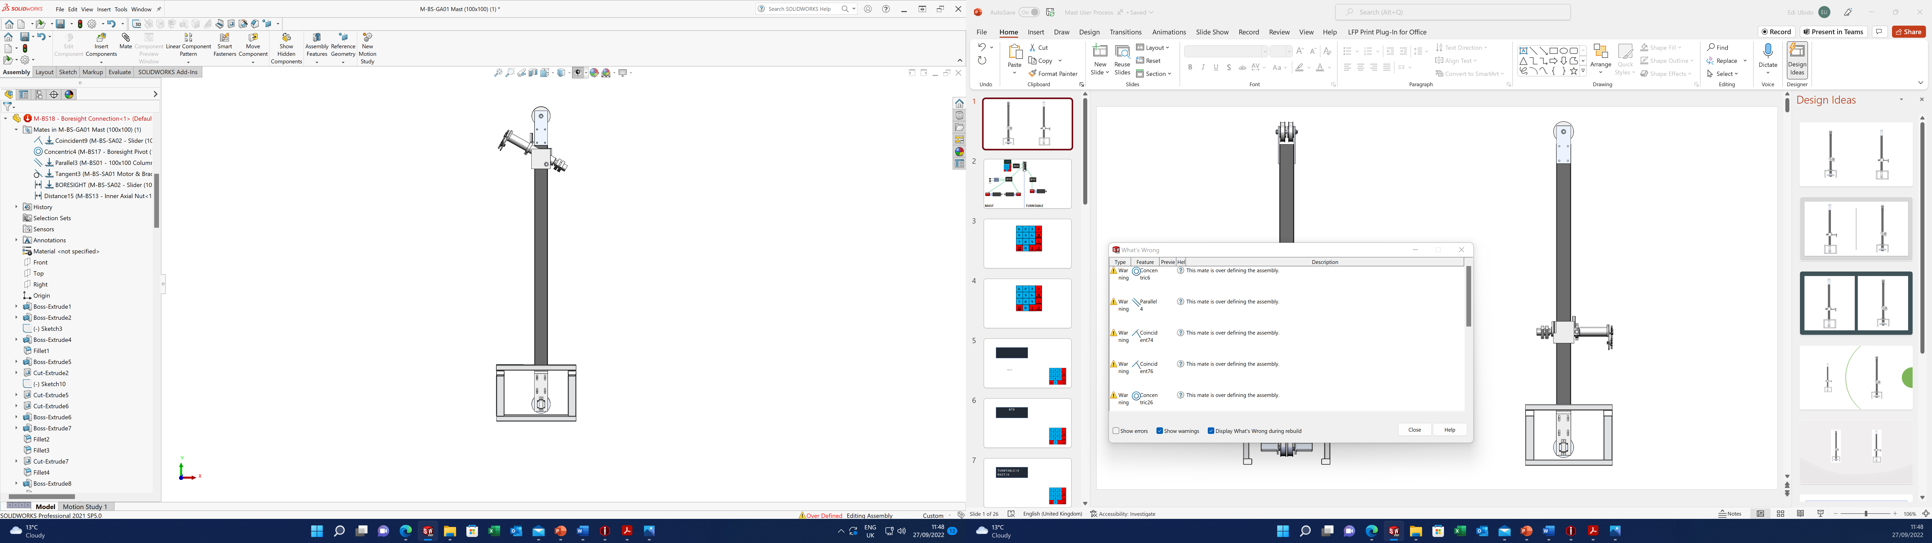

Slide 3
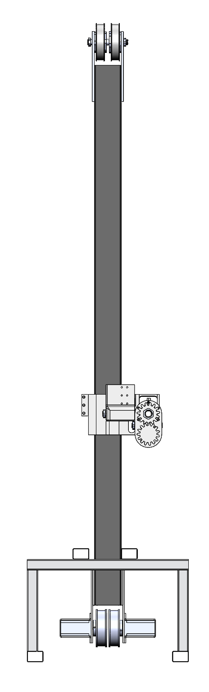
Motor A
Motor B

Slide 4
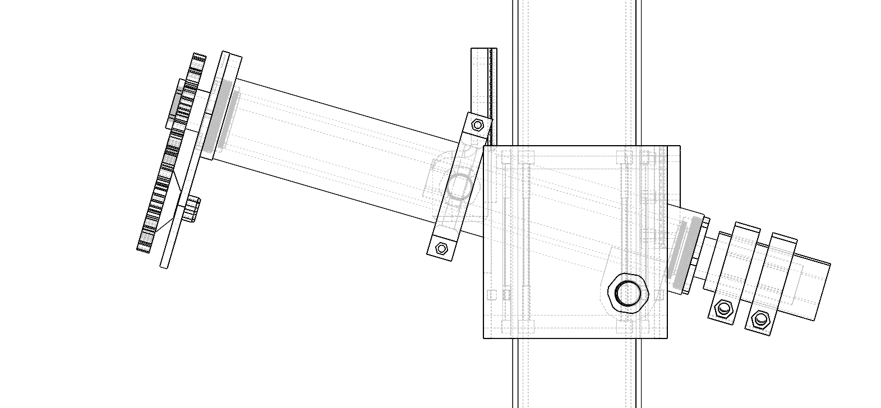

Slide 5
1500
A & B will rotate 3 times
Motor B then rotates an extra half a turn

Slide 6
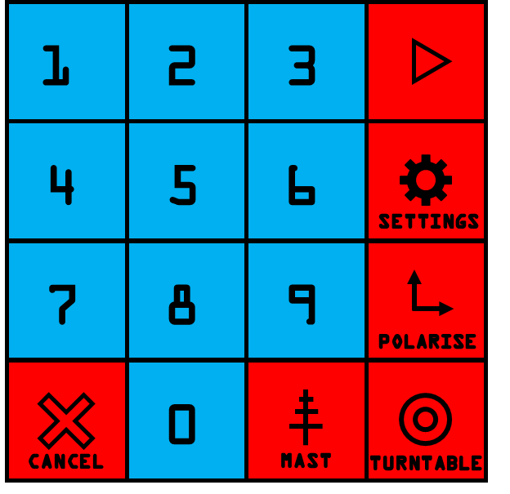
ESP32
RELAY
ESP32
ESP32
RELAY
24V
DRIVER
DRIVER
DRIVER
Motor A
Motor B
MAST
TURNTABLE

Slide 7
ESP32
RELAY
ESP32
ESP32
RELAY
24V
DRIVER
DRIVER
DRIVER
Motor A
Motor B
MAST
TURNTABLE

Slide 8
1
2
3
4
5
6
SETTINGS
7
8
9
POLARISE
0
CANCEL
MAST
TURNTABLE

Slide 9
1
2
3
4
5
6
SETTINGS
7
8
9
POLARISE
0
CANCEL
MAST
TURNTABLE

Slide 10
Turn on

Slide 11
NTD

Slide 12
TURNTABLE:X
MAST:X

Slide 13
TURNTABLE:X
MAST:X
Turntable

Slide 14
TURNTABLE not connected
Display for 5 seconds

Slide 15
TURNTABLE:X
MAST:X

Slide 16
TURNTABLE:Ref
MAST:Ref
Turntable and mast must return to 0 once switched on
When you connect turntable
they both need to return to 0 while displaying “Ref”

Slide 17
TURNTABLE:
MAST:
When the limit switch is reached

Slide 18
TURNTABLE:
MAST:

Slide 19
TURNTABLE
Angle:
180

Slide 20
TURNTABLE
Angle:180
Press to go

Slide 21
TURNTABLE
Angle:180
Display until turntable is in correct position
Don’t let user enter a new angle until it has finished

Slide 22

TURNTABLE
Angle:180
Press Mast at any time to go to mast

Slide 23
MAST
P:0
HEIGHT:

Slide 24
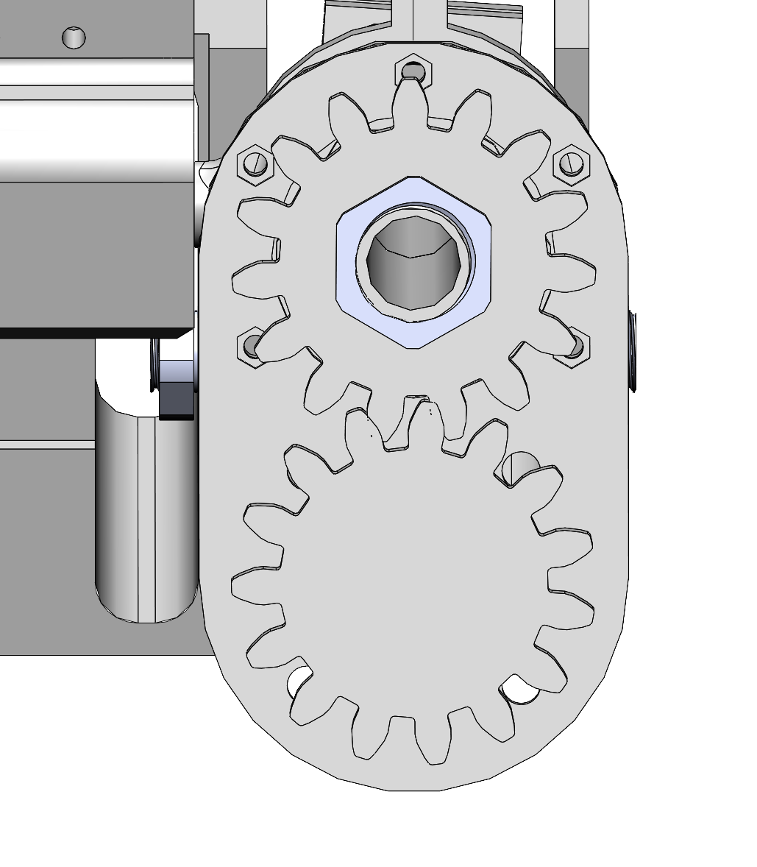
MAST
P:0
HEIGHT:
Press “Polarise” to switch solenoids and therefore to rotate mast to 90º or vice versa
RELAY
RELAY
24V

Slide 25
MAST
P:90º
HEIGHT:
Wait for 5 seconds for action to complete
RELAY
RELAY
24V

Slide 26
MAST
P:90º
HEIGHT:
Type height (between 1000 and 4000)

Slide 27
MAST
P:90º
HEIGHT: 1567

Slide 28
MAST
P:90º
HEIGHT: 1567
Press

Slide 29
MAST
P:90º
HEIGHT: 1567
Show while the mast gets its position

Slide 30
MAST
P:90º
HEIGHT: 1567

Slide 31
While this shows don’t allow a new value to be entered while this shows

